Slide 1
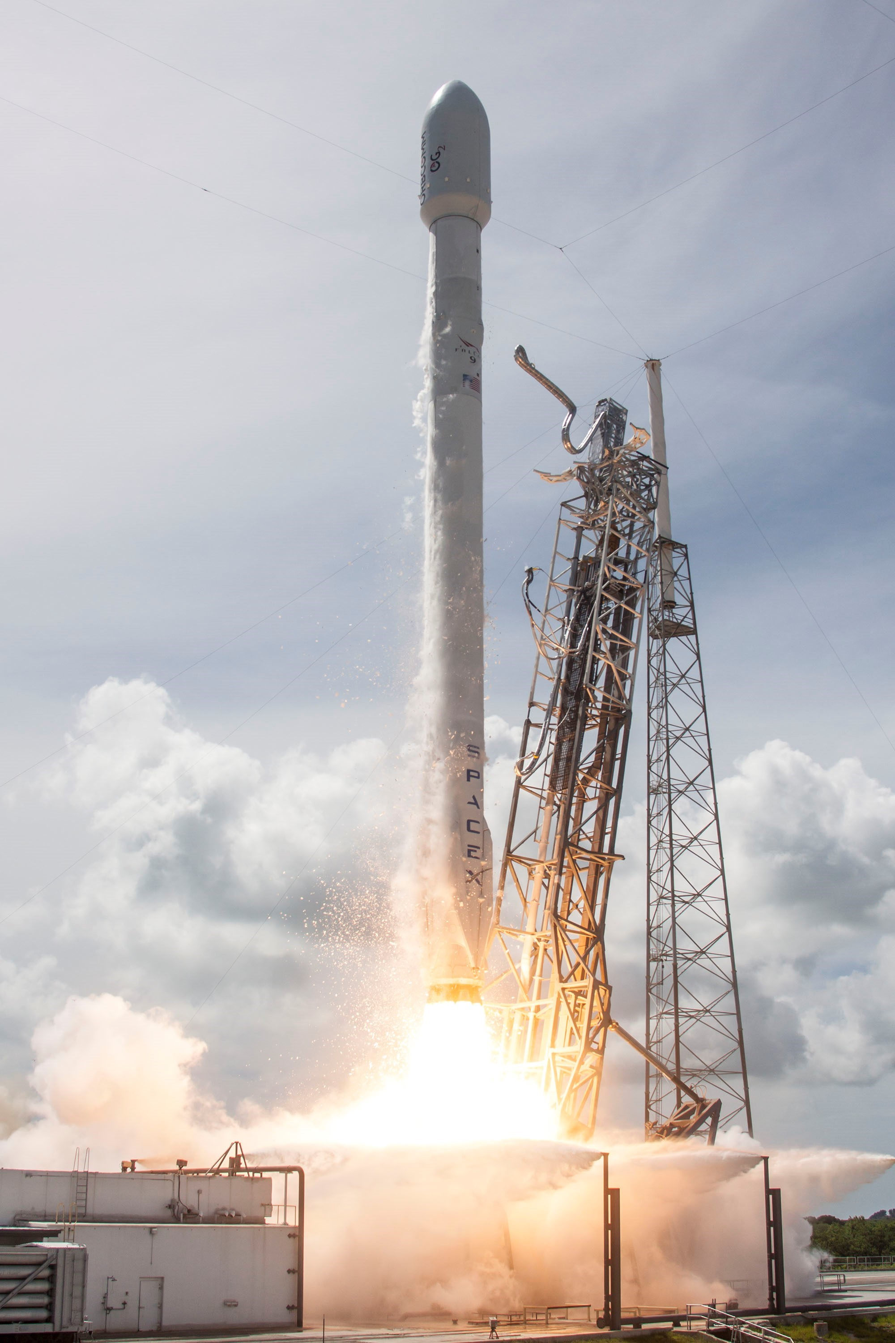




SpaceJMP:
Programming with Multiple Virtual Address Spaces
Izzat El Hajj, Alexander Merritt, Gerd Zellweger,
Dejan Milojicic, Reto Achermann, Paolo Faraboschi,
Wen-mei Hwu, Timothy Roscoe, Karsten Schwan
Notes:
Thanks for coming to this talk. My name is Alex Merritt
This was an effort that started at HP Labs last summer, and was
led by three people – Izzat, myself, and Gerd -- while we were interns

Slide 2
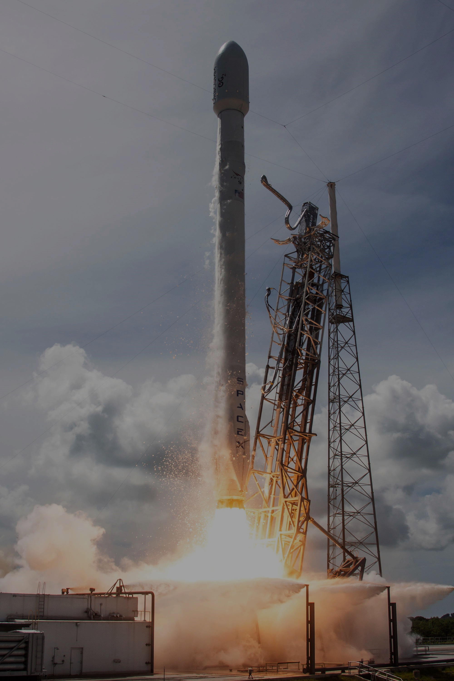
SpaceJMP:
Programming with Multiple Virtual Address Spaces
Serialization is costly
Overcome insufficent
virtual address bits
Izzat El Hajj, Alexander Merritt, Gerd Zellweger,
Dejan Milojicic, Reto Achermann, Paolo Faraboschi,
Wen-mei Hwu, Timothy Roscoe, Karsten Schwan
Let applications
manage address spaces
Notes:
SpaceJMP is an OS design and a set of compiler techniques
that elevate virtual address spaces to become first-class citizens.
With the ability to explicitly allocate and manage their address spaces,
applications can quickly modify their mappings to physical memory
by explicitly switching out their address space.
This model allows us to avoid data structure marshaling,
and to efficiently create multiple virtual mappings into massive pools of physical memory when there aren’t enough translation bits.

Slide 3

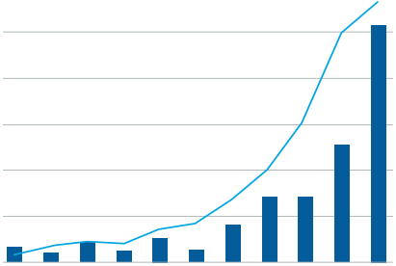
Enormous Demand for Data
$5
600
Invested Captial ($Billion)
$4
500
No. of Deals
$3
300
In-memory real-time analytics
$2
200
$1
100
2004
2005
2006
2007
2008
2009
2010
2011
2012
2013
2014
“How much data is generated every minute?” ¹
Venture Investments in Big Data Analytics Companies²
¹Source: DOMO, Data Never Sleeps 3.0, 2015
²Source: SVB, Big Data Next: Capturing the Promise of Big Data, 2015
Notes:
We’re seeing a large growth in data generated and collected across a variety of online platforms.
Thousands to millions of transactions are processed every minute.
At the same time, venture capitalists are funding more and more startups that mine this data,
with systems processing such data in memory and close to real-time.
One way to accomplish this is to use large shared-memory platforms.

Slide 4
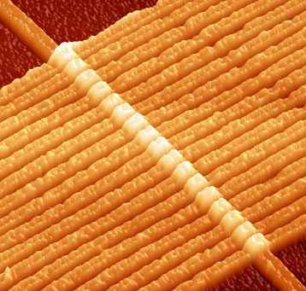
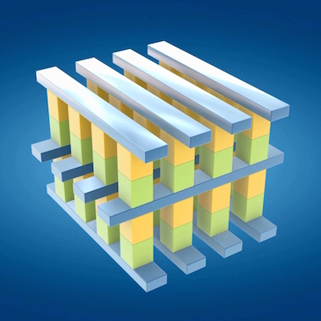
Memory-Centric Computing
Server
High Radix Switches
NVM
Blade
DRAM
CPU
CPU
DRAM
DRAM
SoC
Memristor
DRAM
CPU
CPU
DRAM
DRAM
SoC
...
...
load + store
Network
...
3D XPoint
DRAM
CPU
CPU
DRAM
DRAM
SoC
Shared nothing
Private DRAM
Network-only communication
Data marshaling
Shared something¹
Private DRAM
Global NVM pool
  Byte-addressable
  Near-uniform latency
¹Faraboschi, et al. Beyond Processor-Centric Operating Systems. HotOS’15
Notes:
We are also seeing a transformation in computing systems,
as Stanley's keynote highlighted.
Large systems are typically shared-nothing,
where private DRAMs are updated from messages marshaled over networks.
Computing systems are looking more like shared-something where many SoCs with some private memory
have access to a large shared memory store, composed of technologies like the memrister or 3dxpoint.
Connecting the two are high-radix switches, providing byte-addressable access to this memory,
with near-uniform latency.
Our work focuses on the capacity they provide, not the persistence.
What are the challenges in programming such systems?

Slide 5
Sharing Pointer-Based Data
Symbol Table
Pointer Data Structure
list|0x8D40
tree|null
Serialization via file system
Marshaling costs
Secondary representation
0x8000
Region-based programming
Fixed base addresses
region conflicts!
Special pointers
map+swizzling or use offsets!
Contiguous Virtual Region
No control over the address space!
0x8000
Virtual Address Space
Memory Region
L
Virtual Address Space
0x4000
base
offset
0x8D40
0x4000
+
0x0D40
=
0x4D40
region pointer
(absolute)
region pointer
(relative)
Notes:
Applications manipulate information using numerous pointer-rich data structures.
Sharing and storing this data is important, but using file adds costs.
An alternative is using region-based programming.
A region is a contiguous range of virtual memory.
Pointer data is created within it, and referenced by something like a symbol table at a known location.
Say we have a process that wants to use this region – it will map it in.
Since we used absolute pointers in our structure, we must map at a fixed base address.
What if we are unable to obtain this due to libraries or other regions occupying that space? Conflict.
We should have created our structure with relative pointers.
Unfortunately this means either that each pointer is converted to the absolute in the critcal path, or,
we lengthen the map operation to locate and swizzle each pointer.
These challenges arise because – as we’ll see shortly – we have limited control over the address space

Slide 6
What About Large Memories?
2⁵⁶ = 64 PiB (or more)
Physical Memory
Memory mapped region?
No: not enough VA bits
What to do?
Remapping
Many processes
Challenges
Data partitioning
Coordination
region 1
VAS
region 1
Awkward and inefficient designs
2⁴⁸ = 256 TiB*
region 2
region 2
remap
Single Process
region 1
region 2
region 3
Multiple Processes
*Intel x86-64 Processors.
Notes:
Memory centric systems may have massive memory sizes.
Let’s take a look at how one might program them.
Start with 64 petabytes of physical memory – 56 address bits required.
I want to access all of it – map it into my address space?
CPU only has 48 bits, even though it’s a 64-bit processor. Now what?
Here are two solutions.
Place data in physical memory into regions.
One process then can map in some subset of these regions at a time.
If needed data is in another, we must first unmap from the VAS.
Challenge then reduces to a data partitioning problem – how to arrange data in regions to minimize remapping.
An alternative to avoid remapping is to assign one process to each region, keeps mapped in permanently.
Here, however, we have other costs – coordination among them, scheduling, and IPC.
These designs are awkward to program and still result in inefficient systems.

Slide 7
Legacy Designs are Limiting
fragmentation (holes)
Virtual Address Space
Process Abstraction
glob
code
heap
libraries
stack
kernel
VAS*
PC
registers
256 GiB Range
Latency
map 11 sec.
region
0x8000
100
unmap 2.44 sec.
sec.
2-socket HSW Intel Xeon
512GB DRAM, GNU/Linux
10
void* mmap(...) int munmap(...)
1
region
100
Limited control
  Randomization due to ASLR
  Aliasing not prevented¹
Limited granularity – files, ACL
Costly construction
msec.
construct page table
10
destroy page table
1
region
Why not let applications manage address spaces?
100
µ-sec.
10
1
(not incl. page zeroing or hard faults)
32 KiB
1 MiB
32 MiB
1 GiB
32 GiB
Memory Range Size
¹Linux kernel. FreeBSD has MAP_EXCL to detect aliased regions.
(4-KiB page)
Notes:
These challenges highlight the limitations of the designs of commodity operating systems.
Let's dive into where exactly these limitations come from.
Here we have an abstract representation of a process.
Its VAS is managed transparently by the operating system.
Upon execution many regions are mapped in by the kernel and the dynamic loader.
The interface that enables this are the memory map methods.
Across executions, we will see varying degrees of fragmentation.
Security constraints on production systems such as ASLR will randomize placement of memory regions, such as libraries.
Why does this matter?
Take the region programming example earlier.
A region with a fixed base address may not be able to be mapped.
Not only that, but some kernels do not prevent aliasing – trying to map a region at a fixed offset will overwrite anything already there!
This can lead to immediate crashing or even data loss.
Sharing files is an additional complexity due to the memory map methods being based on top of the file system interface.
If you want to share part of a file with one process but not with another, having to use the file system complicates this.
We’d need to create two separate files each with different user/group access permissions.
Lastly, memory mapping is costly and is not meant to be performed in the critical path.
We measured the cost to just construct page tables on an unloaded system with half terabyte of memory using one thread, varying the region size.
The relationship is linear for all but the smallest regions. Mapping 256 GB we’d wait 11 seconds.
An interesting point to mention – we used the SHM interface in Linux to measure this.
For whatever reason, it forbids creation of regions more than half the system size.
Address spaces have different controllers and as a developer we cannot easily control the layout as we need to.
So why not give control to the applications?
(people should not be confused that our contribution is user-level mgmt of address spaces)

Slide 8
SpaceJMP: VAS as First-Class Citizen
Process A
[private] Virtual Address Space
PC
VAS*
glob
code
heap
lib
stack
registers
glob
code
Q
S
lib
stack
B’
switch VAS B’
switch VAS (return)
attach VAS B
Q
S
B
Explicit, arbitrary page table “jumping” per thread
add segment to VAS B
copy translations
create VAS (global)
Q
S
create segments
Notes:
SpaceJMP does just that.
This is the idea that SpaceJMP starts with – making a VAS become a first-class citizen.
We give applications directly the ability to create, compose, organize, and destroy address spaces.
Two abstractions are key – the VAS itself and what we call segments – a contiguous region of virtual memory backed by physical memory.
A process will have a default VAS created for it by the kernel on startup – just as in traditional systems.
In order to use a new address space we require a process to attach – creates a private clone of the VAS, with its private data mapped in such as code and stack.
Once attached, a process can request to switch context between the two.
In other words, we’ve provided a technique that enables fast access to different memory regions by swapping page tables.
This is explicitly visible to user-level code and is distinct from systems which provide one logical VAS backed by multiple page table instances.
VASes are not only switched into, but allow data to be left in memory without association from a process.

Slide 9
SpaceJMP: Shared Address Spaces
Process A
[private] Virtual Address Space
PC
VAS*
glob
code
heap
lib
stack
registers
glob
code
Q
S
lib
stack
B’
Q
S
B
Process B
glob
code
Q
S
lib
stack
B’’
registers
PC
VAS*
glob
code
heap
lib
stack
[private] Virtual Address Space
Notes:
Shared access to segments is accomplished easily.
Two processes attach to the same named address space.
Here, each private clone of the VAS has mappings to the common segments, but
maps in only the code and stack regions of the attaching process.

Slide 10


SpaceJMP: Lockable Segments
Process A
[private] Virtual Address Space
PC
VAS*
glob
code
heap
lib
stack
registers
glob
code
Q
S
lib
stack
B’
switch VAS B’ → acquire lock
Segment S is lockable
Kernel forces processes to abide by locking protocol
Q
S
B
switch VAS B’’ → block! (inside kernel)
Process B
glob
code
Q
S
lib
stack
B’’
registers
PC
VAS*
glob
code
heap
lib
stack
[private] Virtual Address Space
Notes:
Should a segment contain code and data which do not support concurrent access,
we implement a property of segments making them “lockable”.
The kernel associates a kernel-resident lock with each segment.
Upon switching into a VAS with a lockable segment, the kernel attempts to acquire the lock on behalf of the process.
No reliance on software acting maliciously.
Other processes tha wish to use the VAS will block upon a switch by the kernel.
Lockable segments is not a tool to prevent unauthorized access to data.
Rather, the kernel may enforce this as a process requests attachment before switching.
Lockable segments are not required to enforce concurrent access.
They are useful in scenarios where we do not trust apps to acquire the lock, such as key-value stores.
User-level code can implement its own synchronization strategies with segments, without using a lockable segment.

Slide 11
Unobtrusive Implementation
BSD struct vmspace
DragonFly BSD v4.0.6
Small derivative of FreeBSD
memory system based on Mach µkernel
Supports only AMD64 arch.
Segment – wrapper around VM Object
VAS – instance of vmspace
Process modifications
Primary and attached VAS set
VAS Switch (as system call)
Lookup vmspace, overwrite CR3
Virtual Address Space
vm_map
vm_map_entry
start; end;
offset; protection;
vm_object*
vm_object
OBJT_PHYS
Resident Pages
SpaceJMP Segment
Notes:
We’ve implemented our design on two very different operating systems – a monolithic BSD kernel, and Barrelfish, a multikernel.
DragonFly is a derivative of FreeBSD with a memory system based on the Mach µkernel.
A VAS is described by a set of memory map entries – a region of virtual memory.
Each points to a Mach VM Object – a type describing the resource holding the data supporting the memory map.
We implement Segments as a wrapper around VM Objects backed by physical RAM, and
a VAS as an instance of the vmspace structure.
Processes additionally have a set of attached address spaces, and
a switch simply overwrites CR3 to point to the page table of the new VAS to switch to.

Slide 12
Unobtrusive Implementation
Capability
retype!
physical address
RAM
Barrelfish OS
SpaceJMP user-level implementation
No dynamic memory allocation in kernel
  all memory is typed – frame, vnode, cnode
  safe via kernel-enforced capabilities
Flexible to experiment with optimizations
Linux port at Hewlett Packard Labs.
x86 PML4
Frame
x86 PTDP
Raw Memory
x86 PTD
Segment
x86 PTE
Page Table
SpaceJMP VAS
user space
App
App
Application
OS node
OS node
OS node
kernel
state replica
state replica
state replica
x86
...
Xeon Phi
ARM
interconnect
Notes:
The second implementation is on Barrelfish.
This is a multikernel design where kernel state is replicated across cores,
each kept consistent using distributed message protocols.
On this kernel, unlike in BSD, user-level directly allocates and manages physical memory – no dynamic allocation in the kernel.
The Barrelfish kernel guarantees safety via capabilities – memory is typed, restricting what user code can do with it.
For example, physical addresses can be safely retyped to actual memory frames for use to hold data, or,
retyped to be used as page tables. This allows user code to manage their own virtual address space.
SpaceJMP again implements Segments as wrappers – here, around Frame capabilities.
A VAS is a wrapper around page table capabilities.
The design of the memory system in Barrelfish compared to commodity monolithic OSes is inverted:
the kernel does not perform any dynamic allocation. Instead, memory is typed, and exposed to user-level
to allocate physical frames directly.

Slide 13
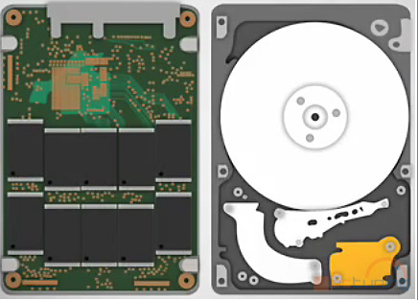
Sharing Pointer-Rich Data
SAMTools Genomics Utilities
2-socket 24-core Westmere
92 GiB DRAM, DF BSD
Normalized Runtime
stage 1
stage 2
stage 3
1.0
0.8
un-marshal
un-marshal
0.6
marshal
marshal
0.4
stage 1
stage 2
stage 3
0.2
Flagstat
Qname Sort
Coordinate Sort
Index
switch
switch
switch
SAMTools Alignment Operations
VAS
1.0
0.8
No data marshaling
Use of absolute pointers
no swizzling, or address conflicts
0.6
0.4
0.2
Flagstat
Qname Sort
Coordinate Sort
Index
Notes:
We’ve demonstrated how SpaceJMP can enable more efficient application designs.
I will highlight two in this talk.
The first is SAMTools – a set of genomics utilities to perform DNA sequence alignment.
Much like big data applications which process data in workflows, such as Hadoop or streaming systems,
each stage in SAMTools reads data from storage, unmarshals it into a pointer-based data structure in memory.
It manipulates this information, marshals it back to storage, and the next stage repeats the process.
Here we illustrate the performance of four stages using two different file type representations – BAM is simply a compressed SAM file format.
Our reimplementation removes the use of disks and does not perform any marshaling.
Instead, a VAS is created to hold the data.
Each stage simply switches into the VAS to perform its work.
Our measurements show the majority of performance gain was eliminating marshaling.
Compared to a memory-mapped implementation using region programming, we found SpaceJMP does not add additional overhead.
Our system provides the ability to use absolute pointers and avoid address conflicts.

Slide 14
Single-System Client-Server
GET per second
C
S
Redis – UNIX Sockets
Serialized data into sockets
Buffer copying
Scheduling coordination
user space
marshal + unmarshal
kernel
buffers
2-socket 24-core Westmere
92 GiB DRAM, DF BSD
Notes:
Many services in data centers rely on object caching.
Typical implementations are key-value stores.
These are implemented using sockets to exchange data; some can be configured to use UNIX domain sockets to avoid TCP overheads.
On memory centric platforms, we argue this is not the correct approach, as
data is still marshaled into socket buffers, and
task schedulers can influence the latency of requests handed off between client and server.
We took Redis, a high-performance in-memory KVS, and evaluated a single server instance as
the number of clients grows.
We want to do better, thus redesigned Redis to take advantage of SpaceJMP.

Slide 15
Single-System Client-Server
GET per second
S
Client VAS
C0
Server VAS
C1
C0
C1
C2
Client VAS
C0
get!
get!
get!
get!
Client VAS
C2
Redis with SpaceJMP
2-socket 24-core Westmere
92 GiB DRAM, DF BSD
Notes:
Our new KVS is called RedisJMP and does not use sockets.
Instead, the server process creates a VAS, initializing all state and code within it.
It then disappears and we’re left with a stand-alone VAS.
Clients then attach and switch into the server VAS.
There, they execute server code to locate objects, and
save the return values to their stack.
An added advantage is parallelism – multiple clients can enter simultaneously, effectively parallelizing the server.

Slide 16
Single-System Client-Server
Requests per second
C0
Server VAS
Client VAS
C1
C0
C1
set!
C1
writer
Client VAS
get!
get!
user
C2
Client VAS
kernel
block!
C0
C2
Varying read-write loads
Scalability – lock granularity
  scalable locks, e.g., MCS
  hardware transactional memory
Typical read/write ratio for KVS ca. 10%
Write Ratio %
2-socket 24-core Westmere
92 GiB DRAM, DF BSD
Notes:
Not all operations are reads, so we have the server use a single lockable segment
to coordinate between readers and writers.
A writer switching into the server VAS will acquire the lock,
blocking any other clients from entering until it completes.
We varied the ratio of reads and writes.
The scalability is limited due to the granularity of the single lock in a segment.
Improvements can be made by using multiple such segments, or
more scalable locks such as MCS, or advanced hardware features such as HTM.
With 10% writes, a ratio typical for KVS, we achieve over 2x the performance compared to Redis

Slide 17
SpaceJMP – Summary
P
P
Physical Memory
attached
VAS 1
VAS 2
P
P
VAS
P
P
attached
Future Work
Persistence – fast reboots
Security – sandboxing
Semantics – transactions
Versioning – fast checkpointing
Takeaway
Promote address spaces to
first-class citizens
Processes explicitly create, attach,
switch address spaces
Notes:
(conclude)
In our paper we describe how we use the compiler to detect and protect against
dereferencing pointers across address spaces.

Slide 18
Backup Slides

Slide 19
Programs: How to Use SpaceJMP
vas_create(NAME,PERMS)
VAS*
VAS
B’
seg_alloc(NAME,BASE,LEN,PERMS)
S
seg_attach(VAS#,SEG#)
VAS B
S
vas_attach(VAS#)
S
vas_switch(VAS#HANDLE)
List *items = // lookup in symbol table
append(items, malloc(new_item))
Notes:
Let’s briefly review what userlevel code looks like in SpaceJMP.
Each action I mentioned previously has an associated system call.
(review them each)
SpaceJMP provides a user-level library that can hide most of this functionality from applications.
Please see the paper for the details.

Slide 20
Programming Large Memories
with a GUPS-like workload
Physical Memory
Updates per second (mil.)
P0
P2
P3
P4
P1
VAS
80
P
re-mapping
60
Multi-
Process
40
OpenMPI busy-waiting
Physical Memory
20
2-socket 36-core HSW
512 GiB DRAM, DF BSD
VAS 1
VAS 2
0
P
SpaceJMP
Notes:
Additional experiments in the paper illustrate how we program large address spaces using a GUPS-like workload

Slide 21
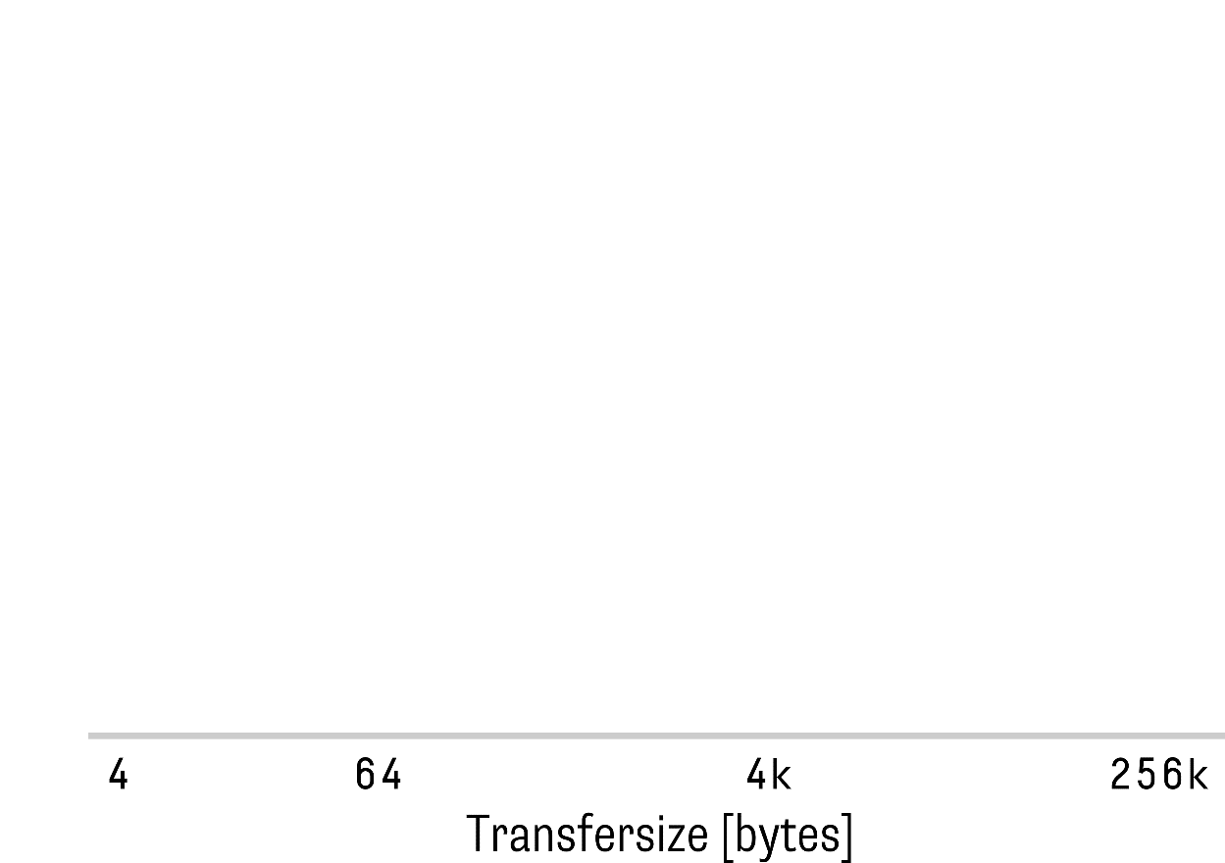
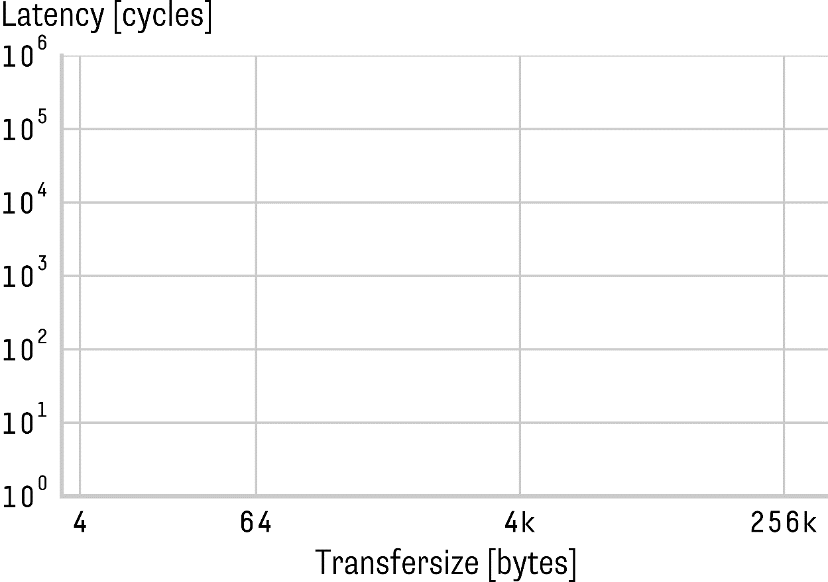
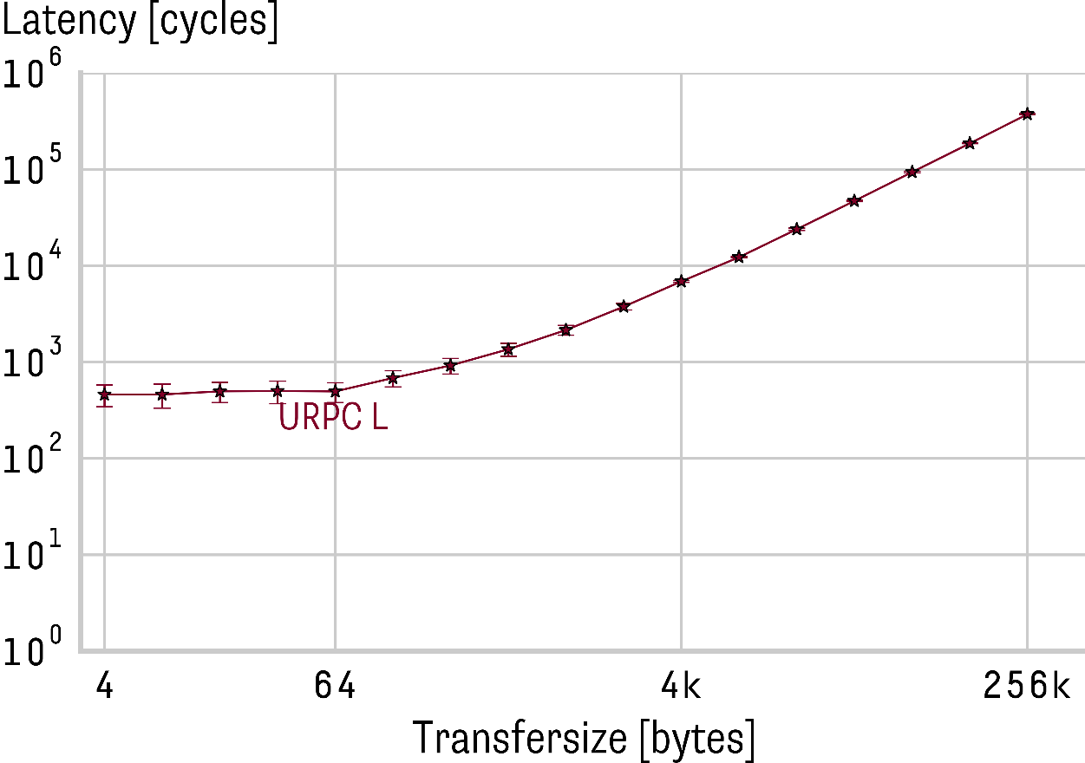
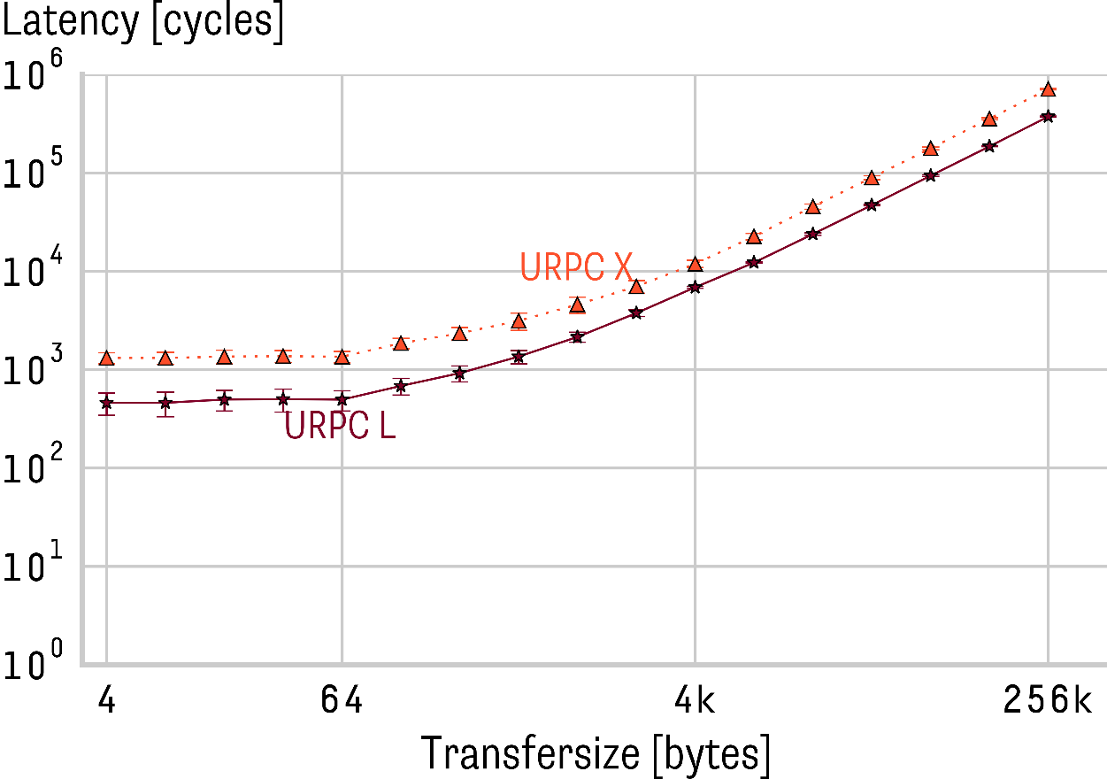
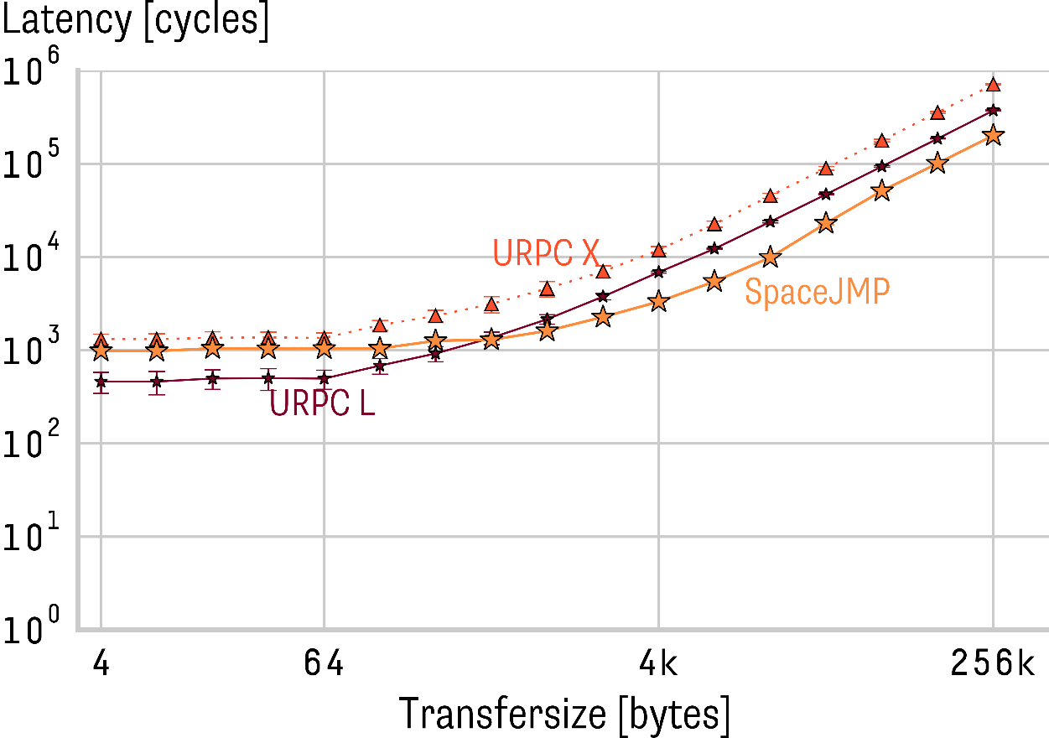
Study: Implications for RPC based communication
Can SpaceJMP support fast RPC?
  Unix domain sockets are ubiquitous
  Faster published inter-machine RPC mechanisms?

Slide 22
Pointer Safety Issues
Risk for Unsafe Behavior
  Pointer dereferences in the wrong address space are undesirable
Safe Programming Semantics
switch v₁
a = malloc
b = *a
c = vcast v₂ b
d = alloca
*d = c
e = *d
a is valid in v₁ only
b is valid in v₁ only
c is valid in v₂ only
d is valid in any VAS
e is valid wherever c was valid

Slide 23
Compiler-Enforced Pointer Safety
Analysis Identifies Potentially Unsafe Behavior
  Analyze active VASes at each program point
  Analyze which VAS each pointer may point to
  Identify dereferences with mismatch between current VAS and points-to VAS (safety-ambiguous)
Transformation Guards Dereferences
  Protect potentially unsafe dereferences with tag checks
  Tag pointers involved in potentially unsafe dereferences
  Tag pointers that escape visibility (e.g. external function invocation, stores, etc.)
a = malloc
b = malloc
switch v
*a
safe dereference
*b
safety-ambiguous dereference

Slide 24
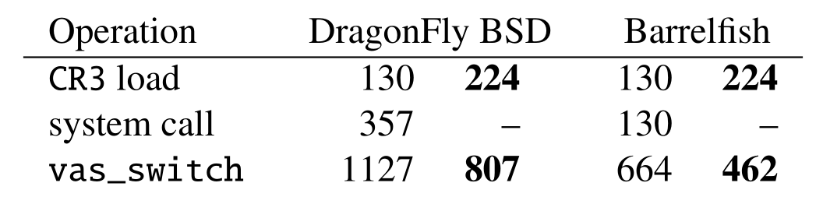
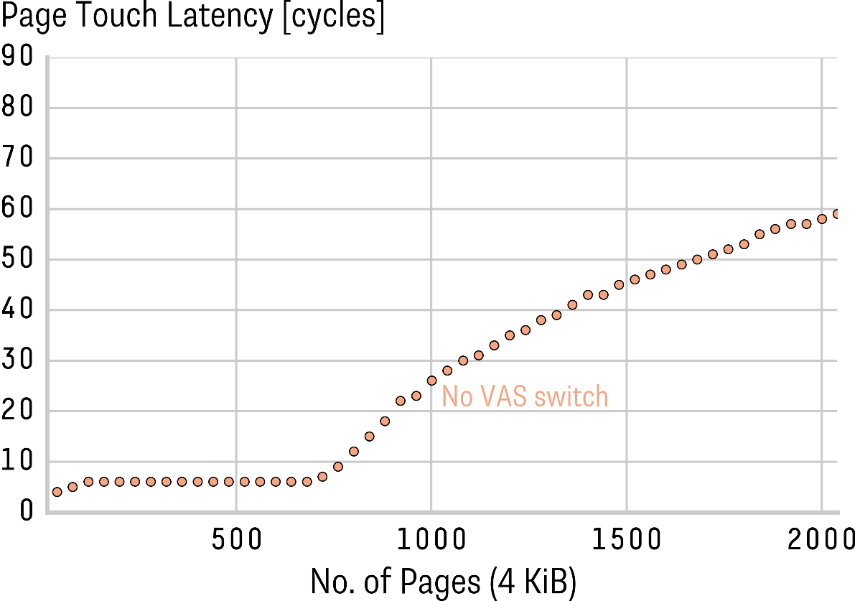
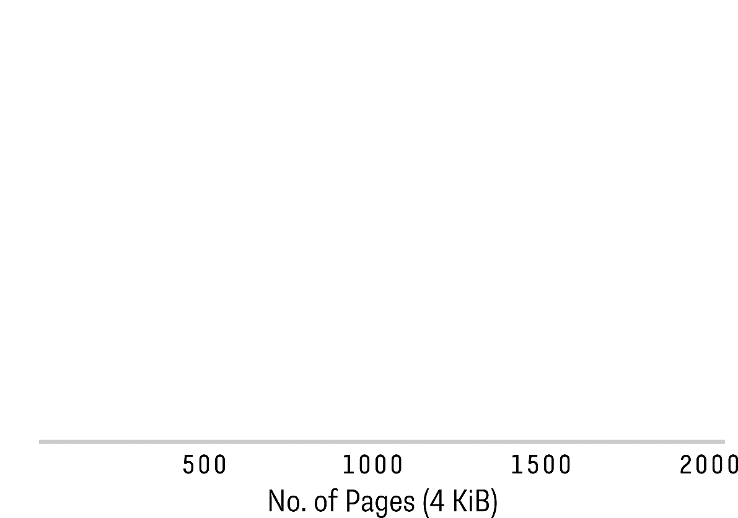
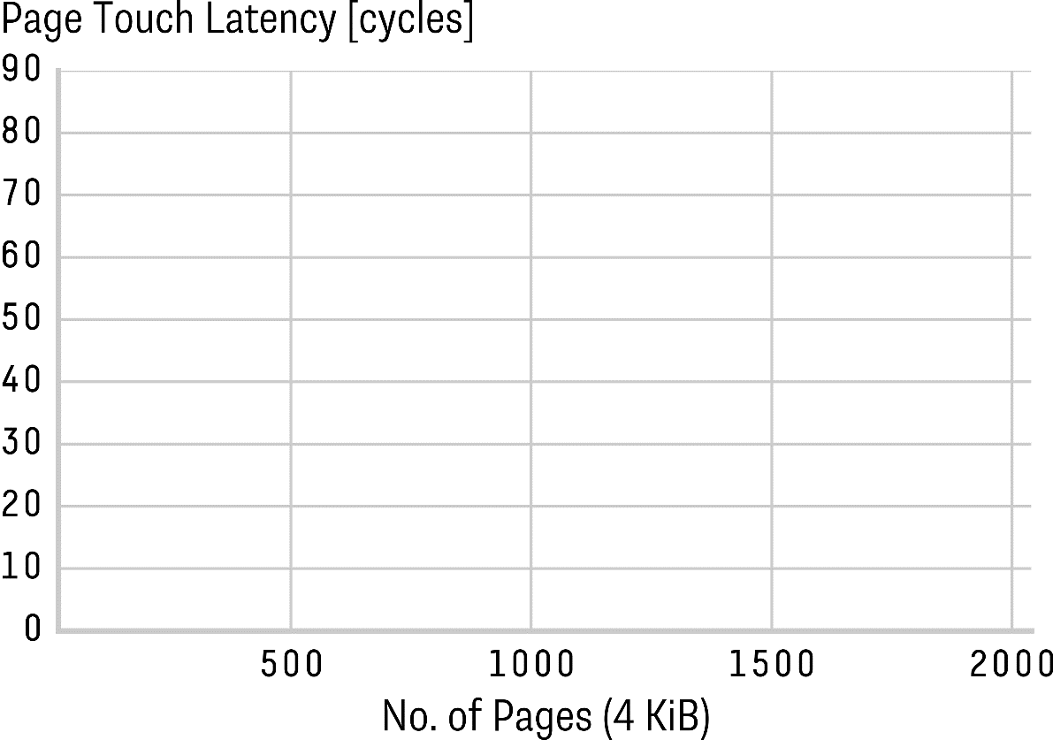
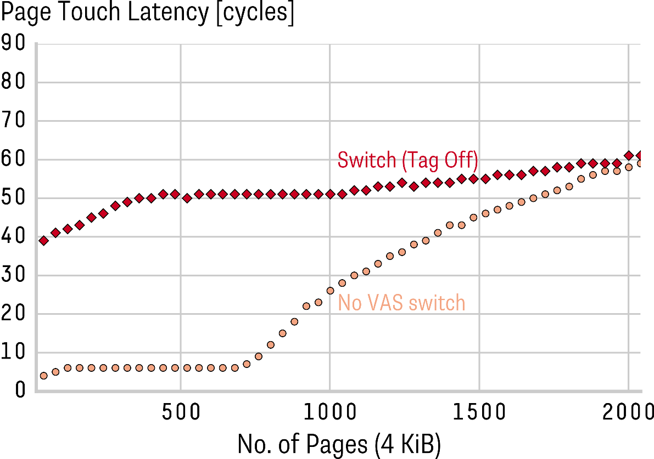
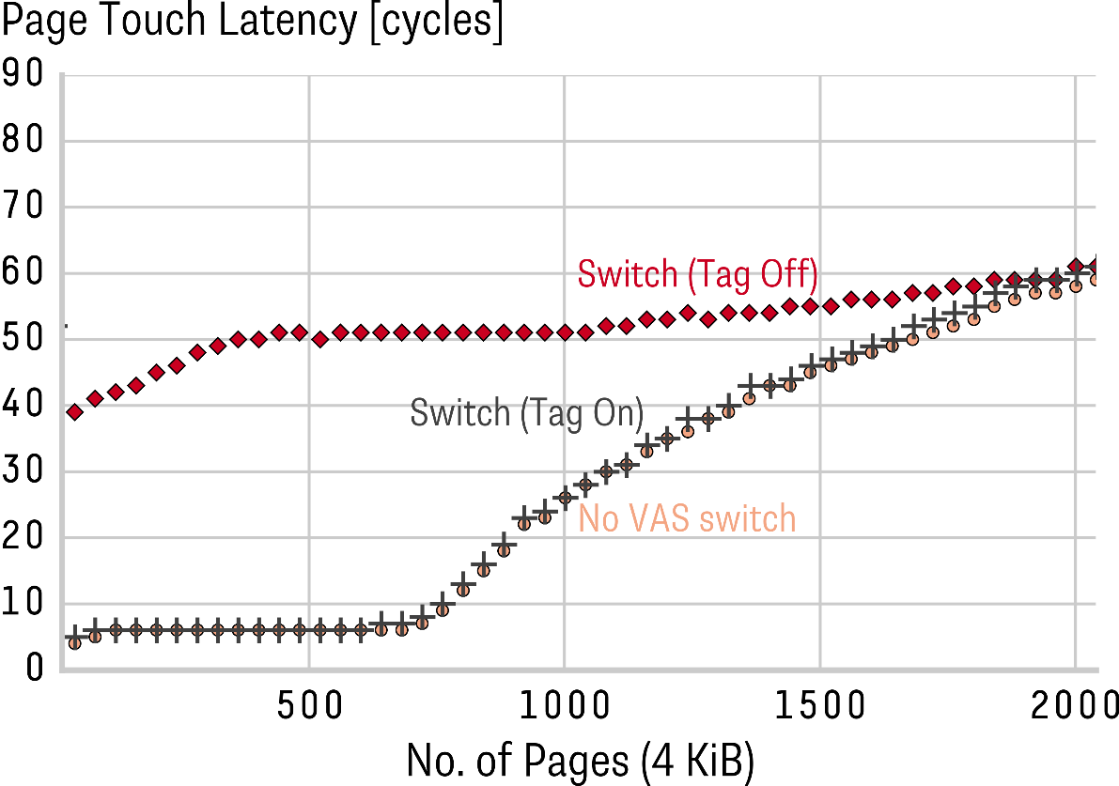
How fast is address space switching?
Switching costs – breakdown
  CR3 write cost increases with tags
  Switch latency lower with tags
  Bold is with tagging
Impact of TLB tagging
  Translations remain in TLB
  Diminishing returns with larger working sets

Slide 25
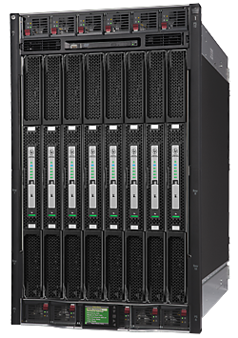
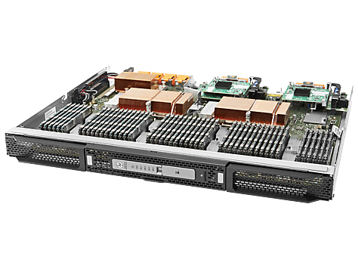
Concrete Systems
Example: HP Superdome X¹
16 sockets, 288 cores (physical)
24 TiB DRAM
Byte-addressable
  cache-coherent
$500K–$1M
Improvements to make
No NVM
Non-uniform latencies
Cache coherence wall
¹Source: Hewlett Packard Enterprise

